Slide 1
Reduced-order physics-DL model for Power systems
erhtjhtyhy
Hongli (BOB) zhao
University of Chicago

Slide 2
Problem setup
Uncertainty in power generation and demand fluctuations
Risk in power transmission networks
Systematic risk: failure events are rare, but interconnected and devastating
Bigger Picture: Characterize likelihoods of cascading failures

Slide 3
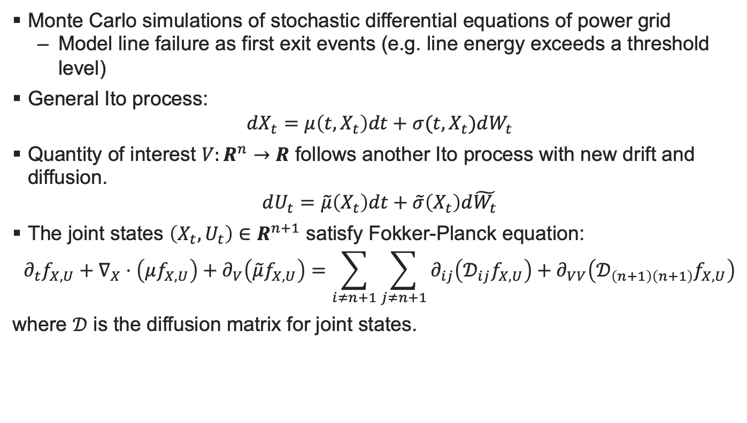
Stochastic dynamical systems
Monte Carlo simulations of stochastic differential equations of power grid
Model line failure as first exit events (e.g. line energy exceeds a threshold level)
General Ito process:
$$dX_{t}=μ\left(t, X_{t}\right)dt+σ(t, X_{t})dW_{t}$$
Quantity of interest $V:R^{n}→R$ follows another Ito process with new drift and diffusion.
$$dU_{t}=\tilde{μ}\left(X_{t}\right)dt+\tilde{σ}\left(X_{t}\right)d\tilde{W_{t}}$$
The joint states $\left(X_{t},U_{t}\right)∈R^{n+1}$ satisfy Fokker-Planck equation:
$$∂_{t}f_{X,U}+∇_{X}⋅\left(μf_{X,U}\right)+∂_{V}\left(\tilde{μ}f_{X,U}\right)={\sum_{i≠n+1}{\sum_{j≠n+1}{∂_{ij}\left(𝒟_{ij}f_{X,U}\right)}}+∂}_{VV}\left(𝒟_{\left(n+1\right)\left(n+1\right)}f_{X,U}\right)$$
where $𝒟$ is the diffusion matrix for joint states.

Slide 4
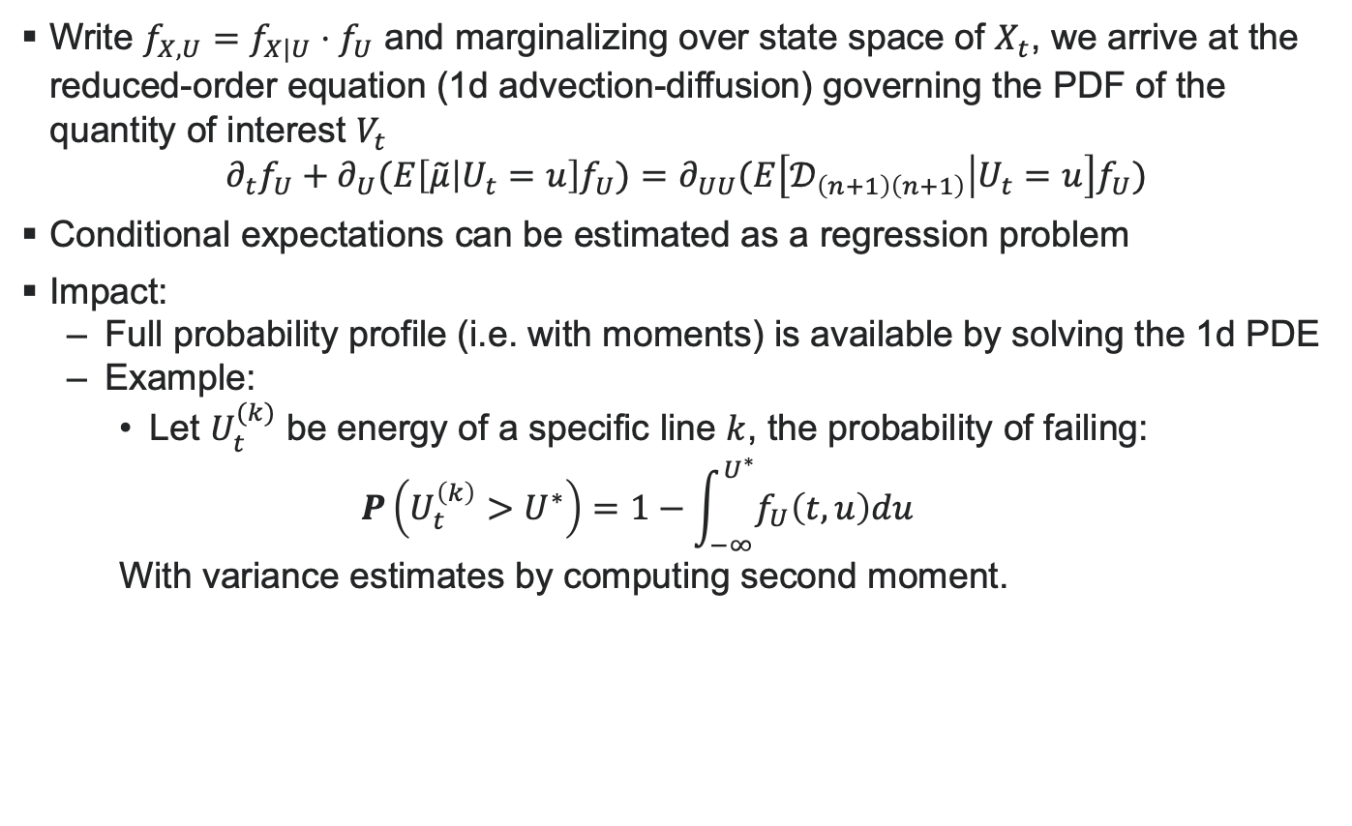
Reduced-order PDF model
Write $f_{X,U}=f_{X|U}⋅f_{U}$ and marginalizing over state space of $X_{t}$, we arrive at the reduced-order equation (1d advection-diffusion) governing the PDF of the quantity of interest $V_{t}$
$$∂_{t}f_{U}+∂_{U}(E\left[\tilde{μ} | U_{t}=u\right]f_{U})=∂_{UU}(E\left[𝒟_{\left(n+1\right)\left(n+1\right)} | U_{t}=u\right]f_{U})$$
Conditional expectations can be estimated as a regression problem
Impact:
Full probability profile (i.e. with moments) is available by solving the 1d PDE
Example:
Let $U_{t}^{(k)}$ be energy of a specific line $k$, the probability of failing:
$$P\left(U_{t}^{\left(k\right)}>U^{∗}\right)=1−\int_{−∞}^{U^{∗}}{f_{U}\left(t,u\right)du}$$
With variance estimates by computing second moment.

Slide 5
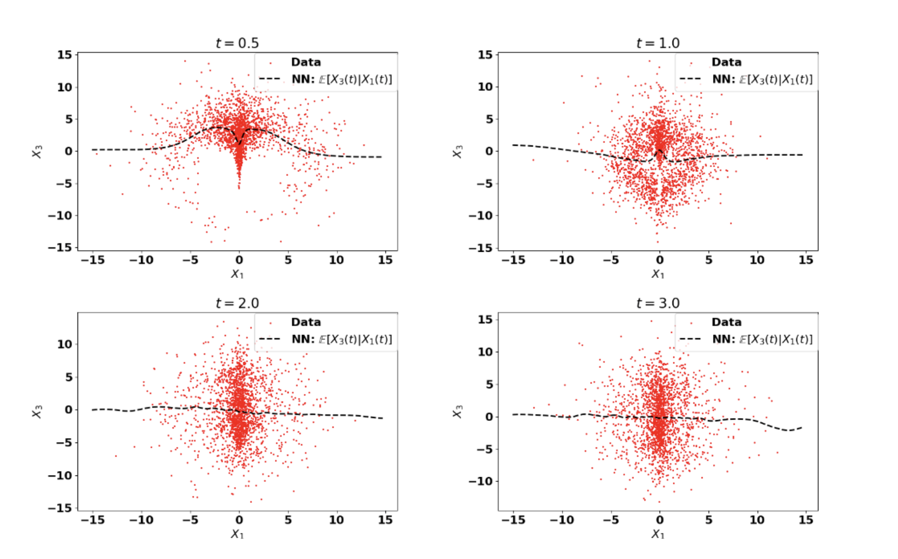
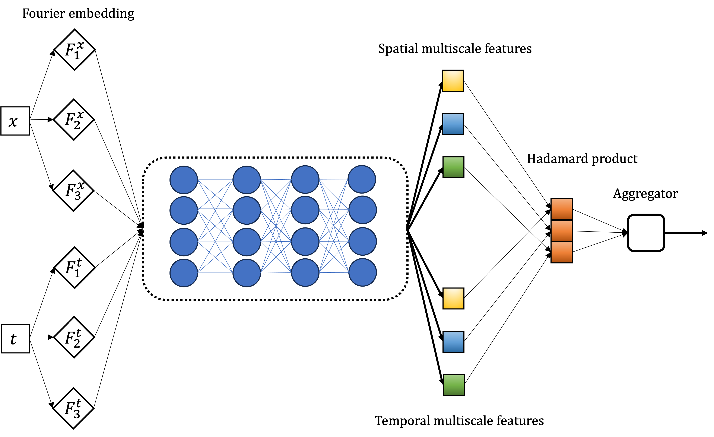
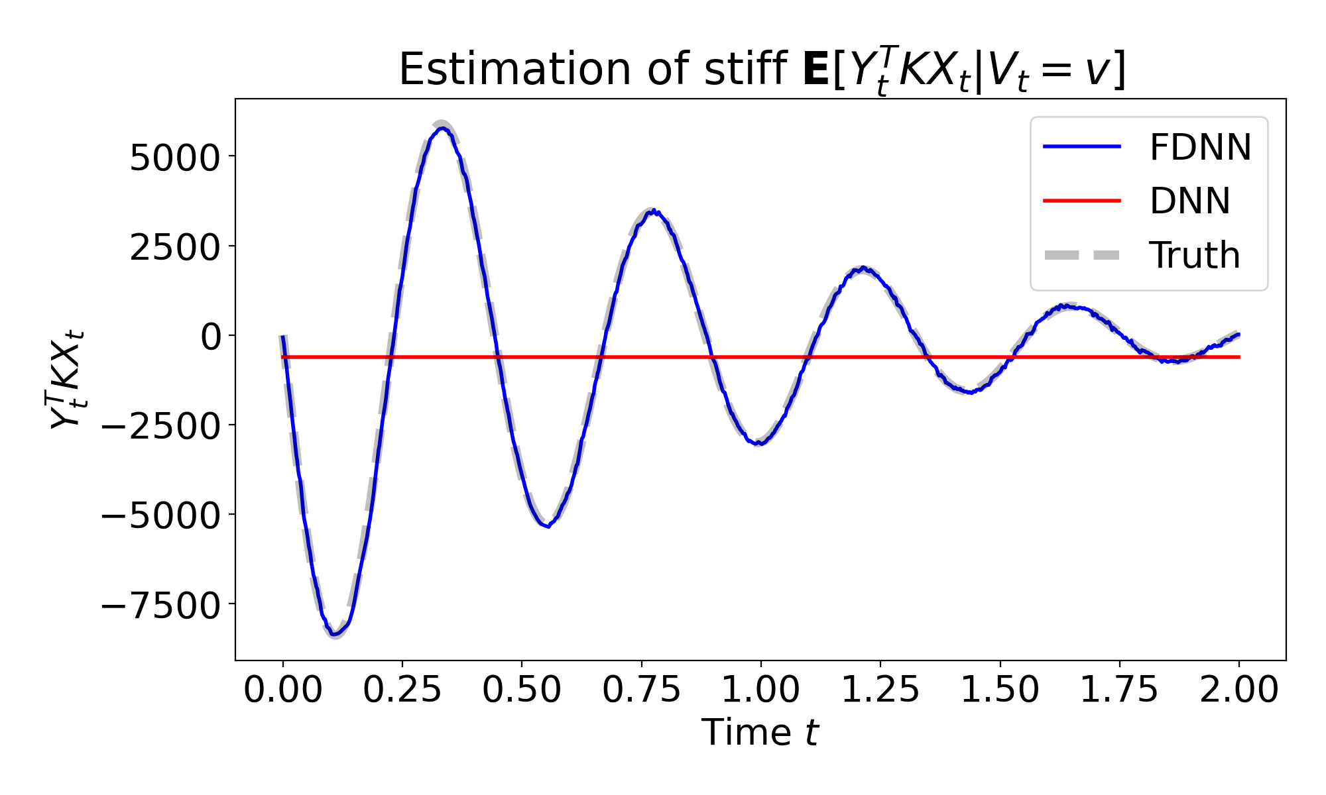
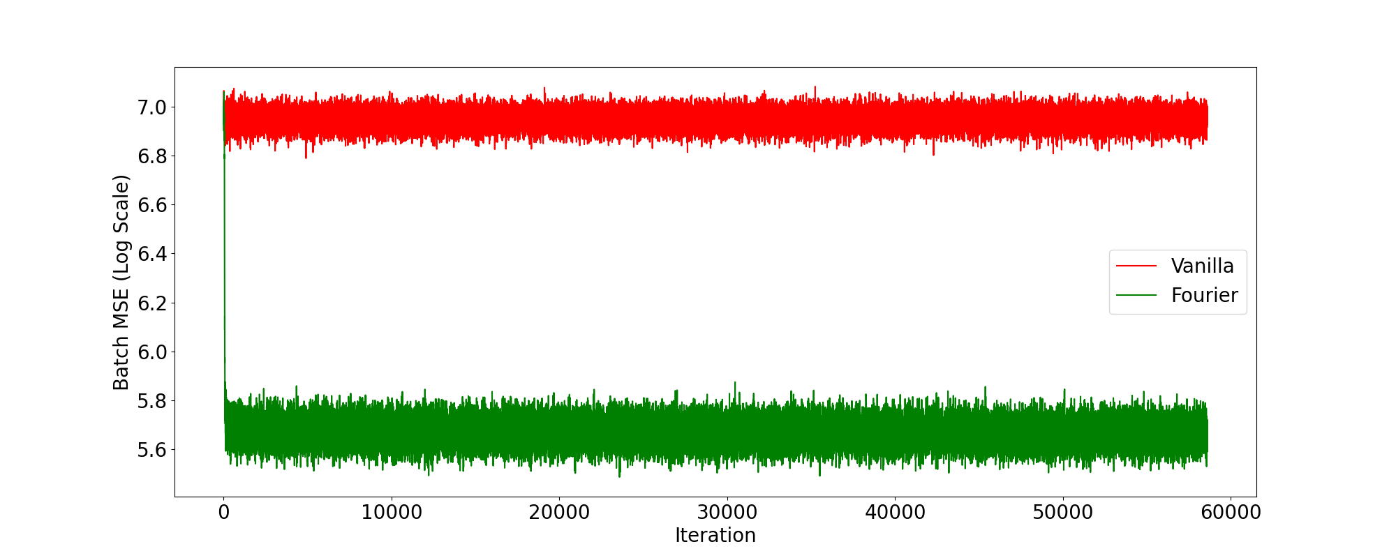
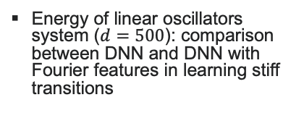
DATA-DRIVEN CLOSURE
Learning conditional expectation using neural networks
Stochastic Kraichnan-Orszag system: Fully connected DNN estimates from trajectory data
Energy of linear oscillators system ($d=500$): comparison between DNN and DNN with Fourier features in learning stiff transitions
(Top) Fourier net architecture
(Bottom) Training loss for DNN (red) and Fourier DNN (green)

Slide 6
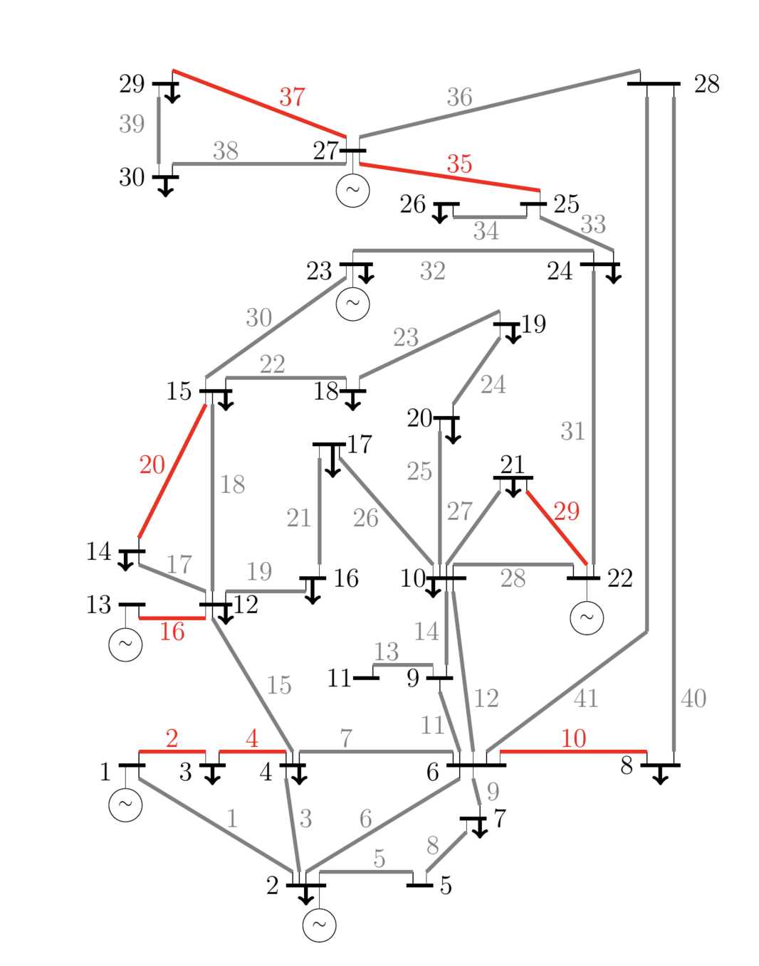
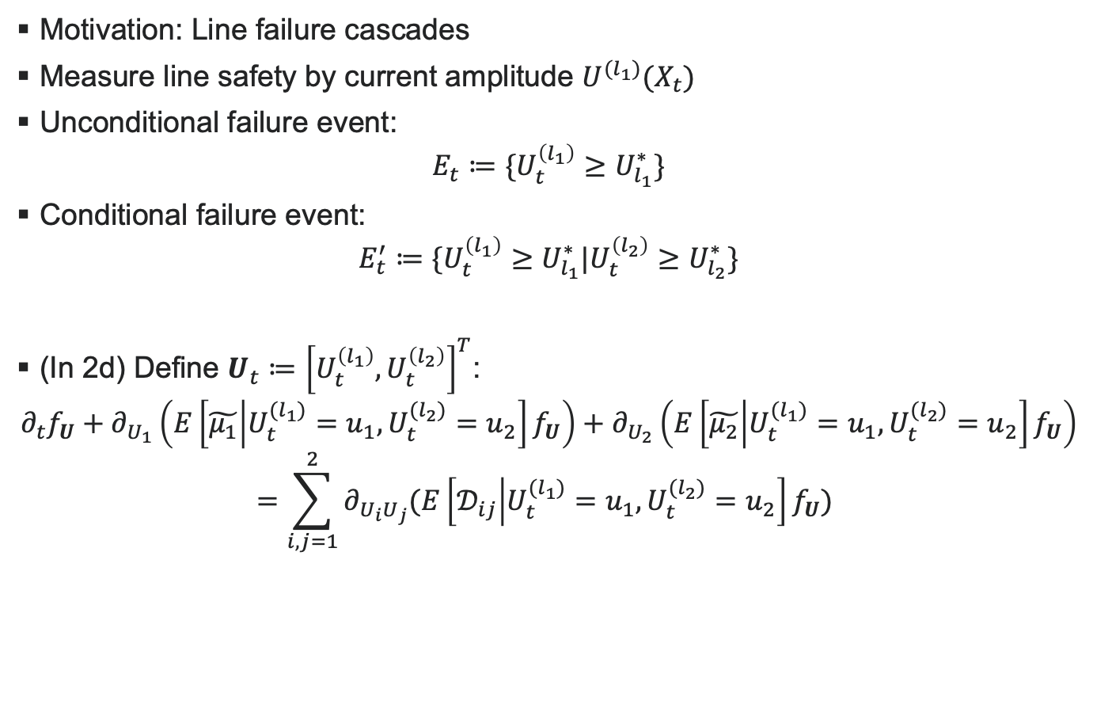
Reduced-order PDF: Multiple dimensions
Motivation: Line failure cascades
Measure line safety by current amplitude $U^{{(l}_{1})}(X_{t})$
Unconditional failure event:
$${E_{t}≔\{U}_{t}^{\left(l_{1}\right)}≥U_{l_{1}}^{∗}\}$$
Conditional failure event:
$$E_{t}^{′}≔\{U_{t}^{\left(l_{1}\right)}≥U_{l_{1}}^{∗}|U_{t}^{\left(l_{2}\right)}≥U_{l_{2}}^{∗}\}$$
(In 2d) Define $U_{t}≔{\left[U_{t}^{\left(l_{1}\right)},U_{t}^{\left(l_{2}\right)}\right]}^{T}$:
$$∂_{t}f_{U}+∂_{U_{1}}\left(E\left[\tilde{μ_{1}} | U_{t}^{(l_{1})}=u_{1},U_{t}^{(l_{2})}=u_{2}\right]f_{U}\right)+∂_{U_{2}}\left(E\left[\tilde{μ_{2}} | U_{t}^{(l_{1})}=u_{1},U_{t}^{(l_{2})}=u_{2}\right]f_{U}\right)$$
$$=\sum_{i, j=1}^{2}{∂_{U_{i}U_{j}}(E\left[𝒟_{ij} | U_{t}^{(l_{1})}=u_{1},U_{t}^{(l_{2})}=u_{2}\right]f_{U}) }$$
IEEE Case 30

Slide 7
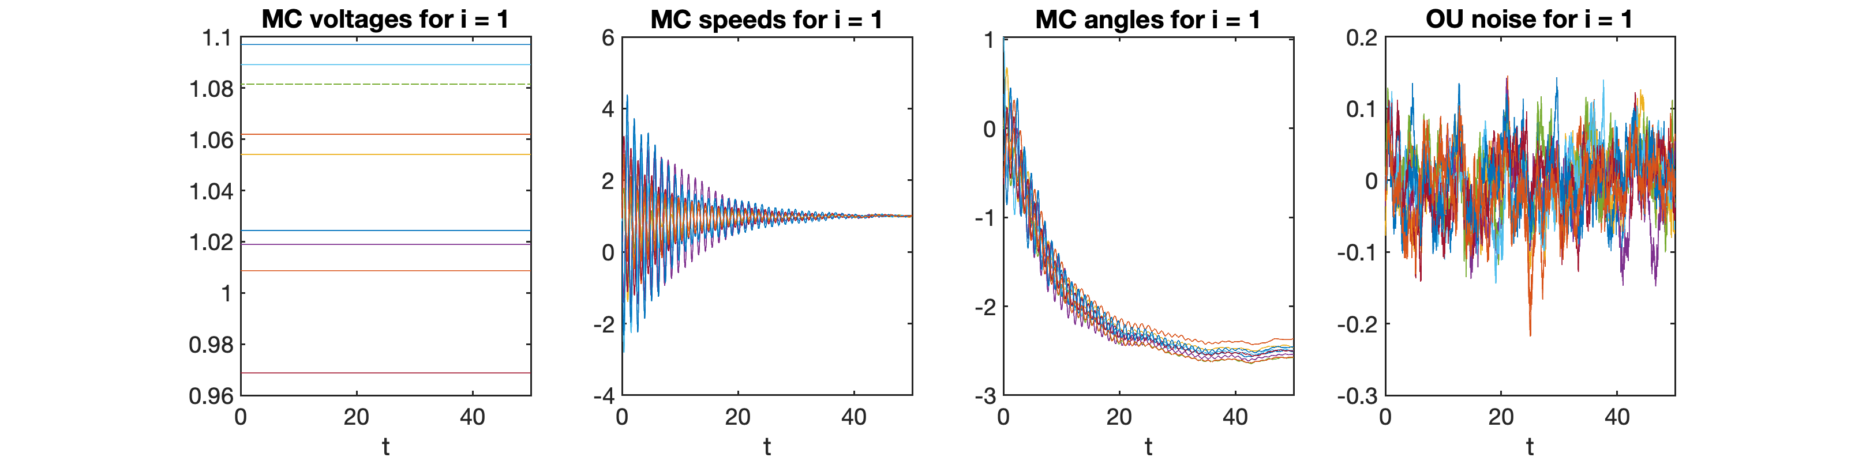
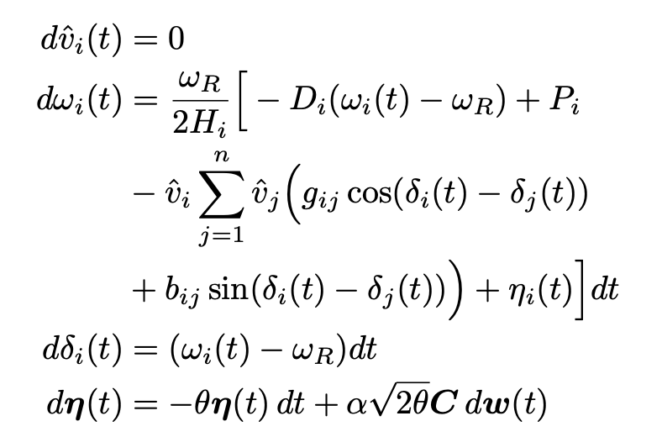
Numerical Simulations
Classical multimachine swing equations with OU noise

Slide 8
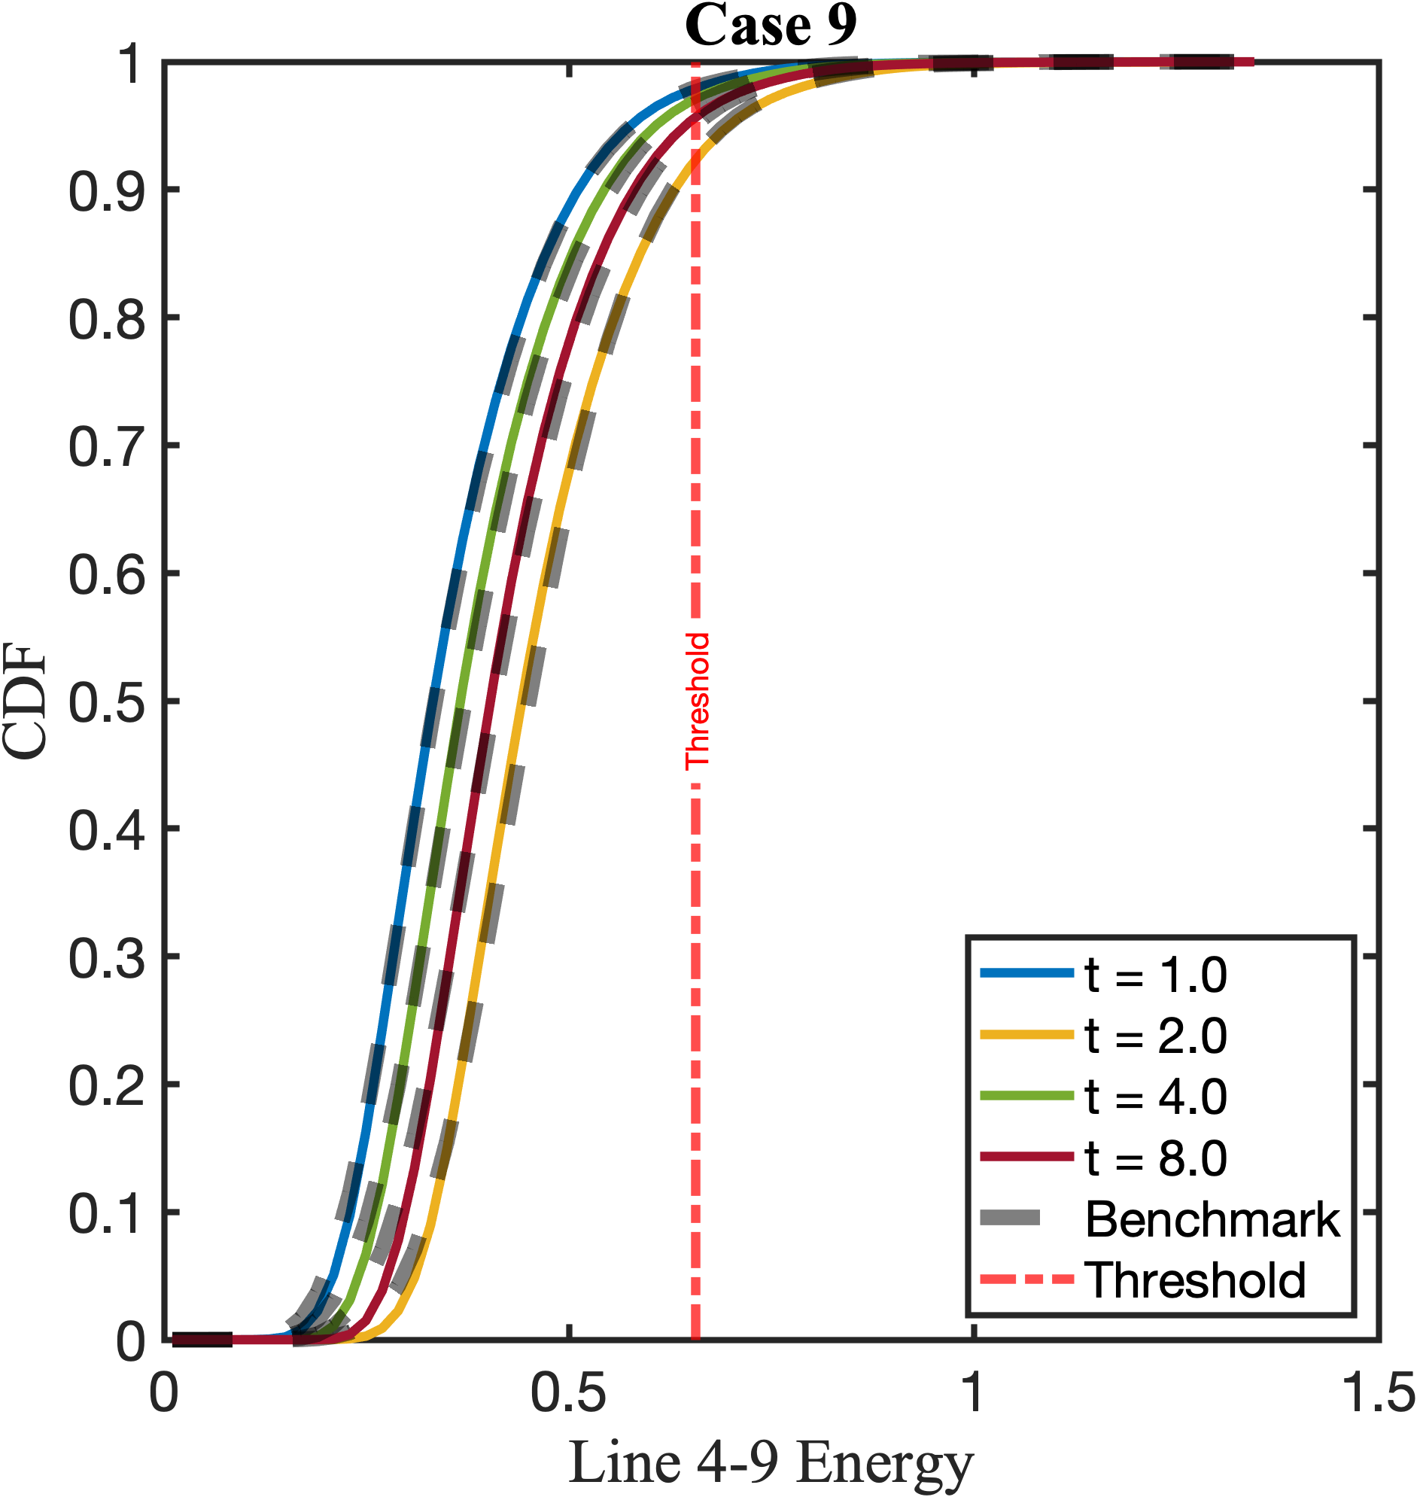
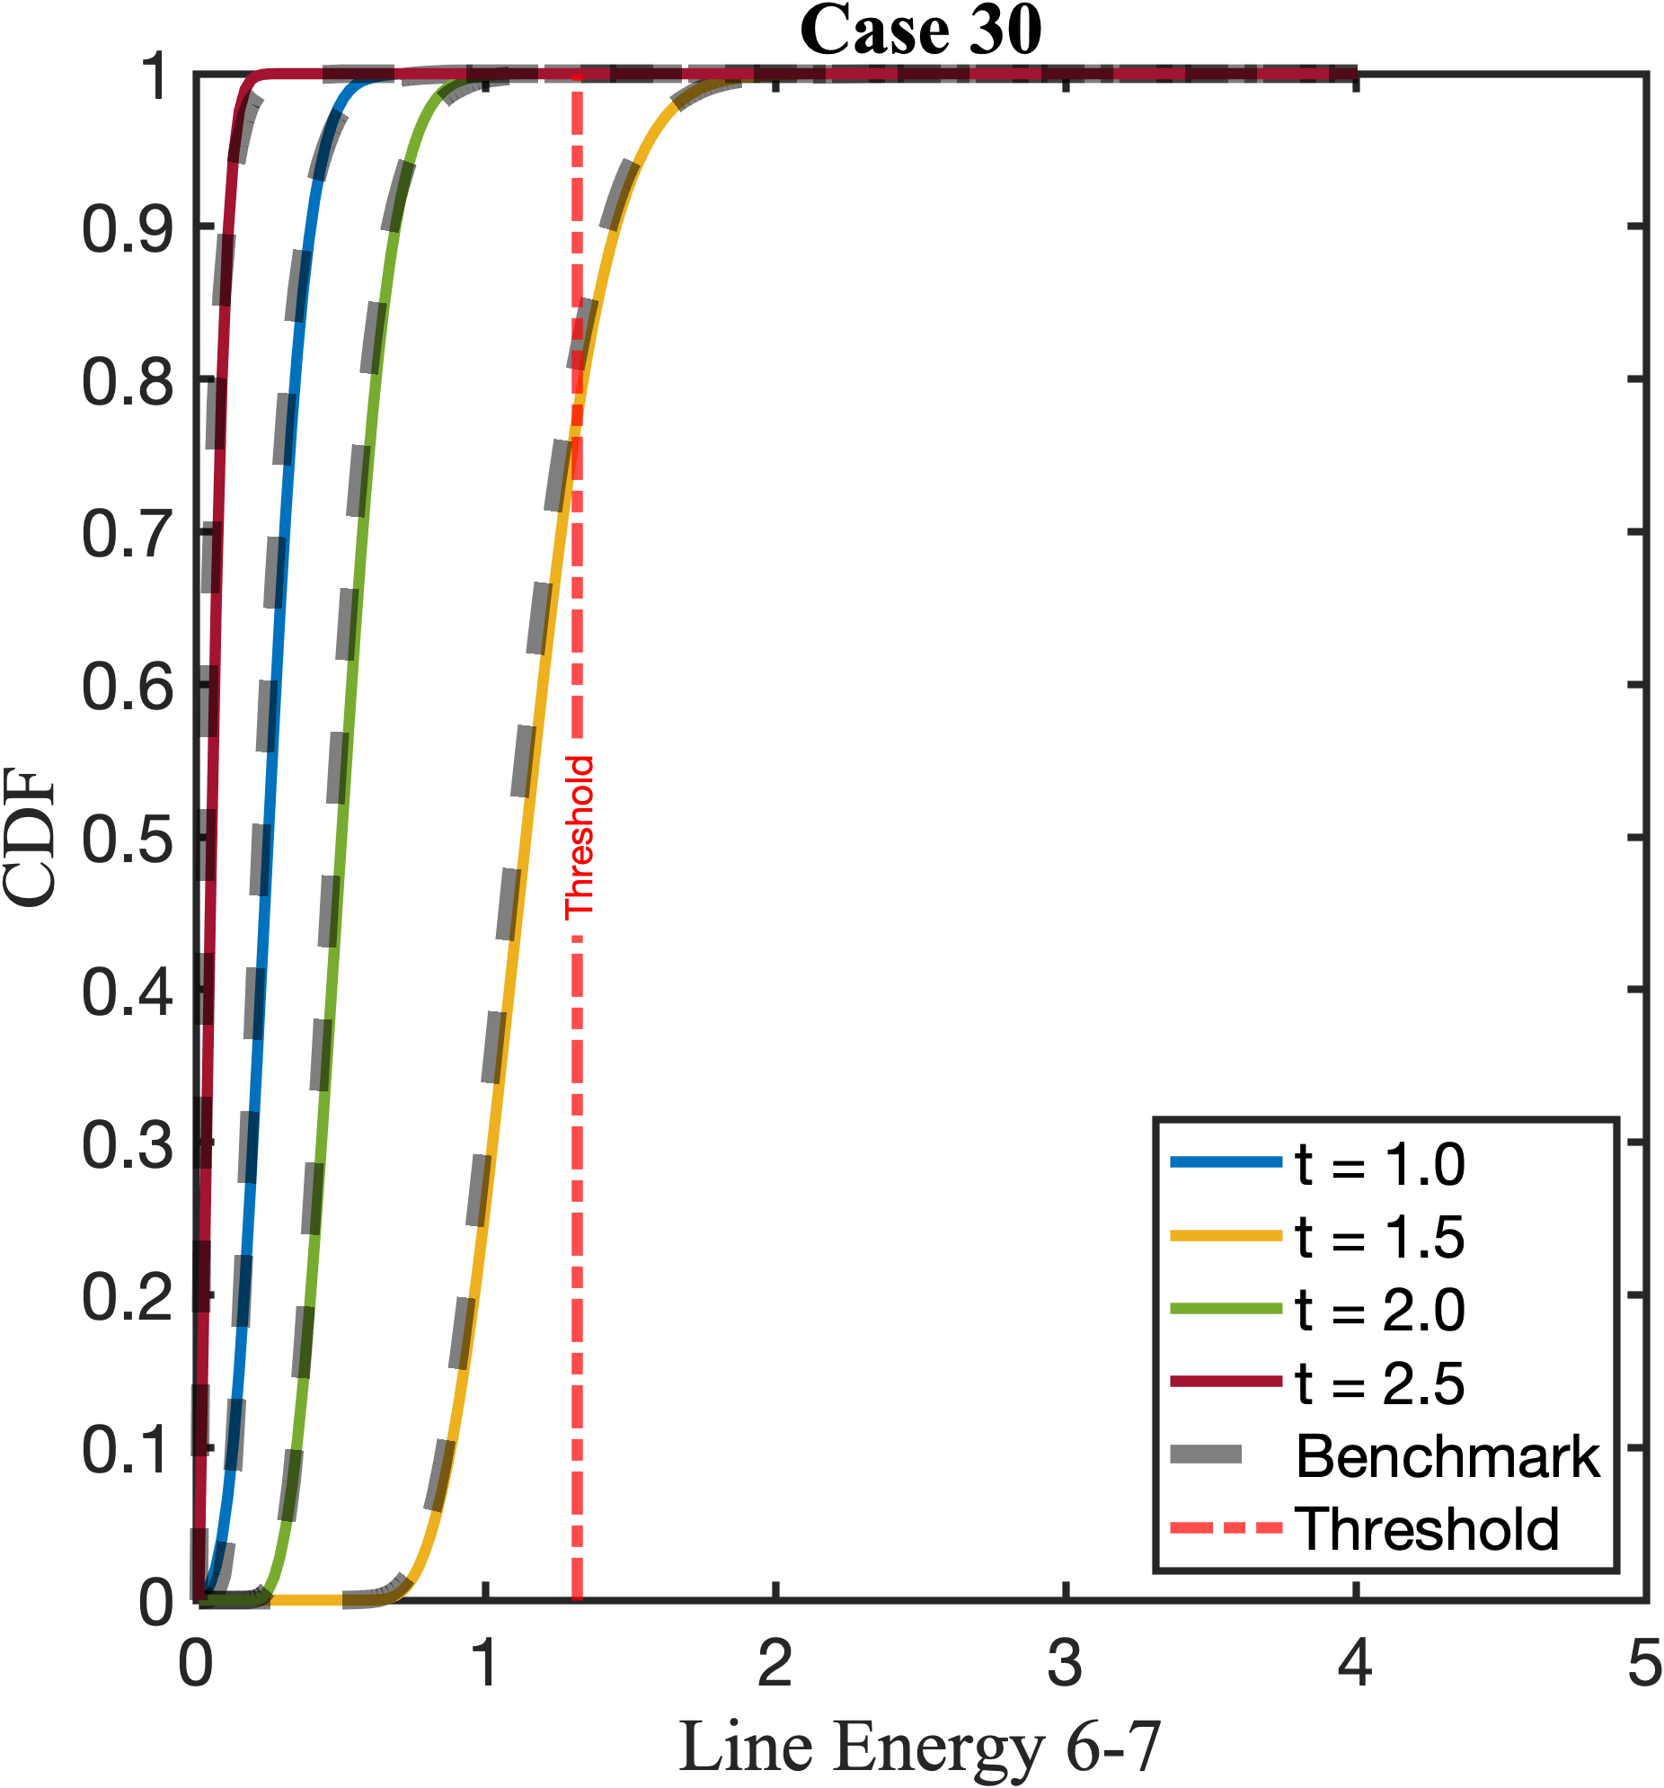
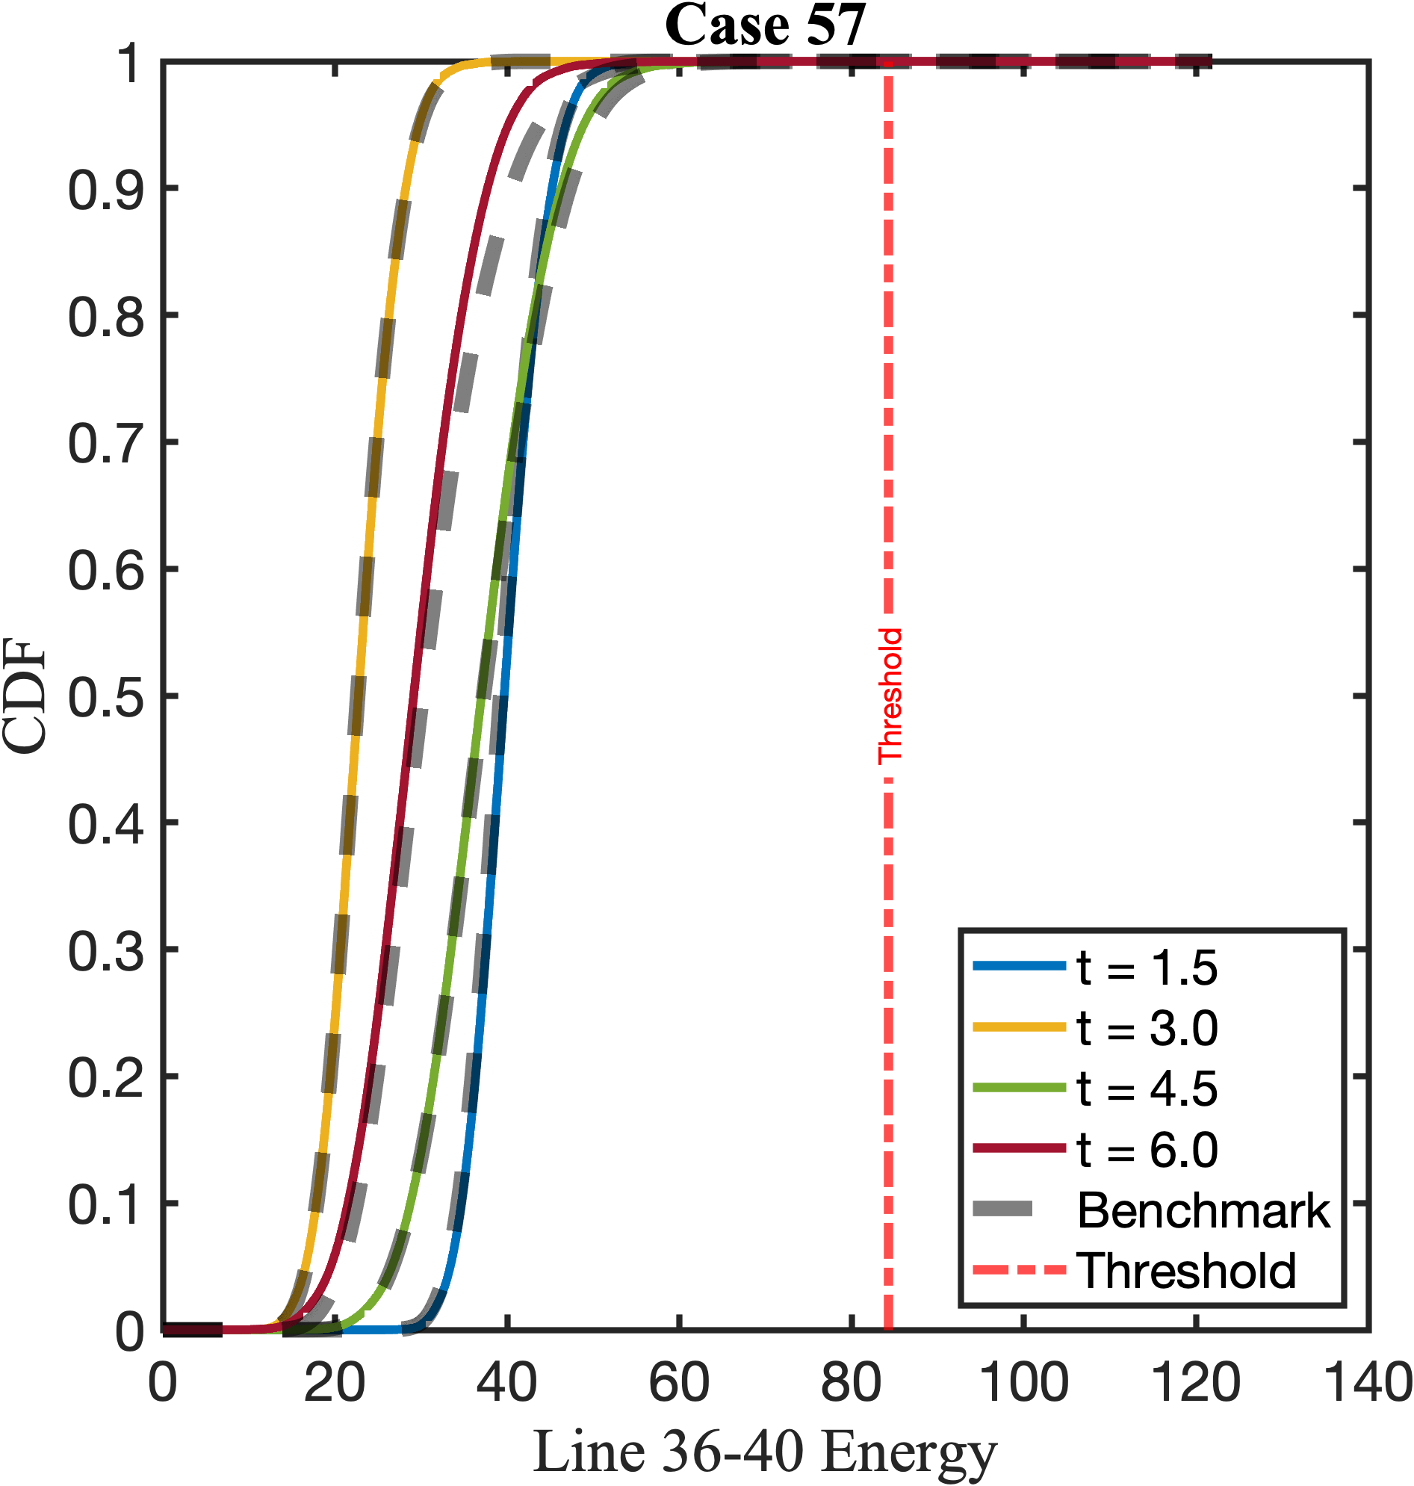
1d Marginal CDF

Slide 9
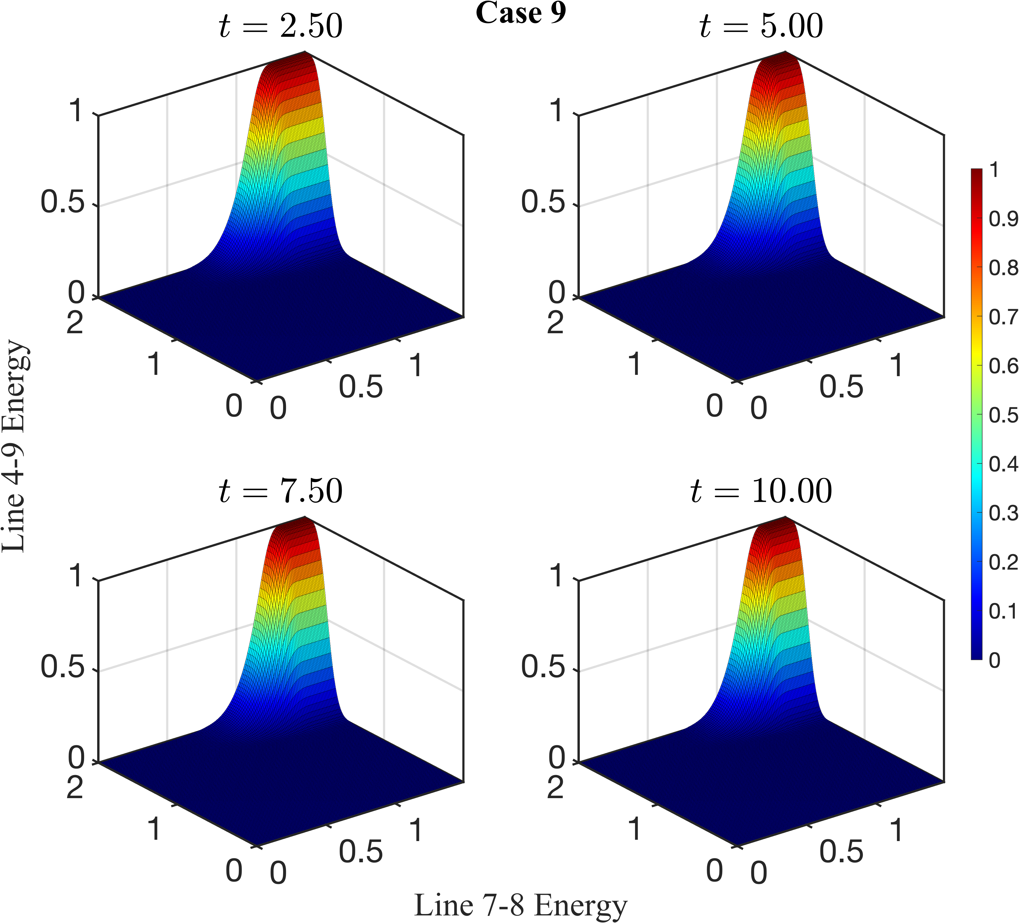
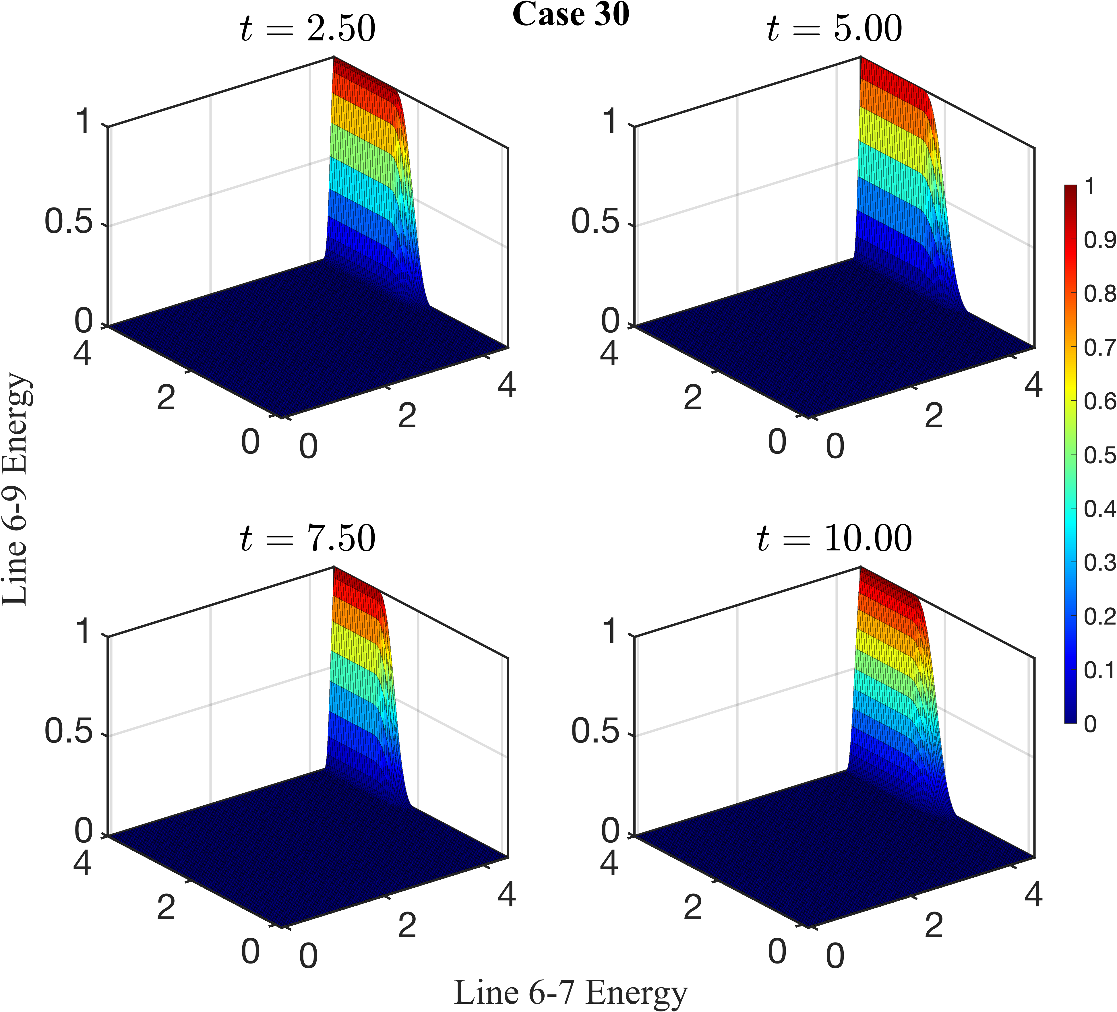
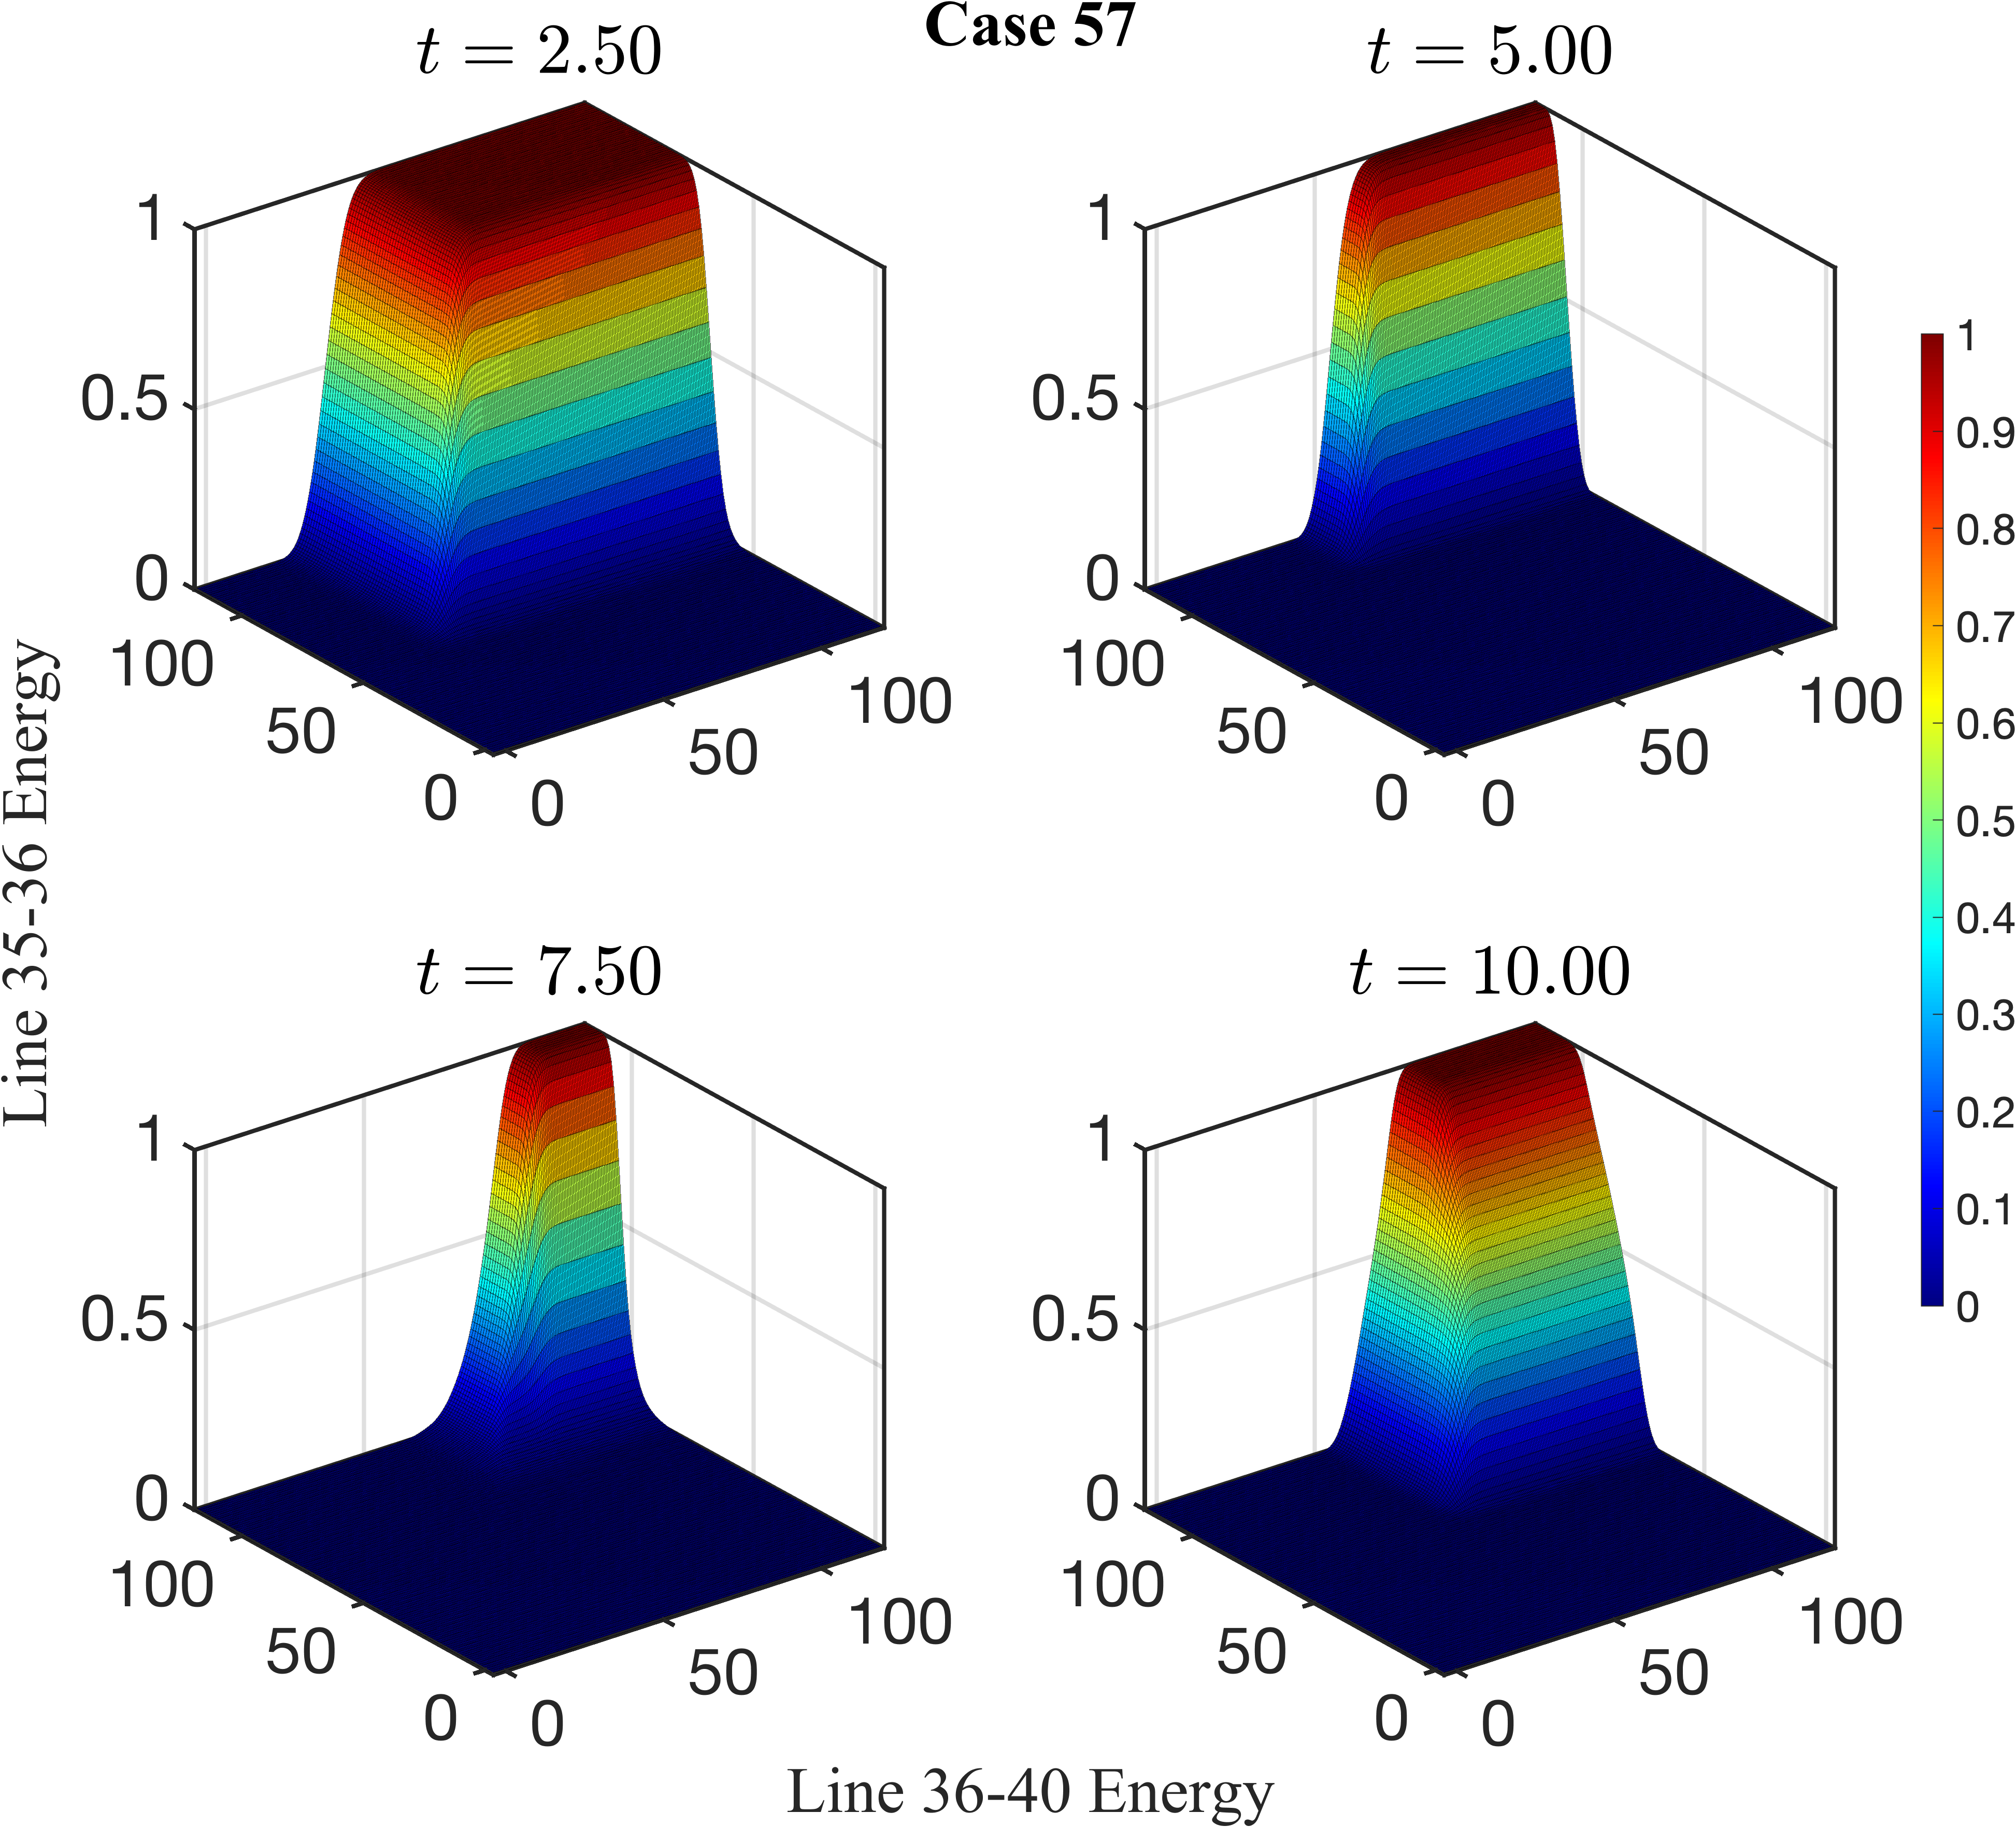
2d joint tail probability

Slide 10
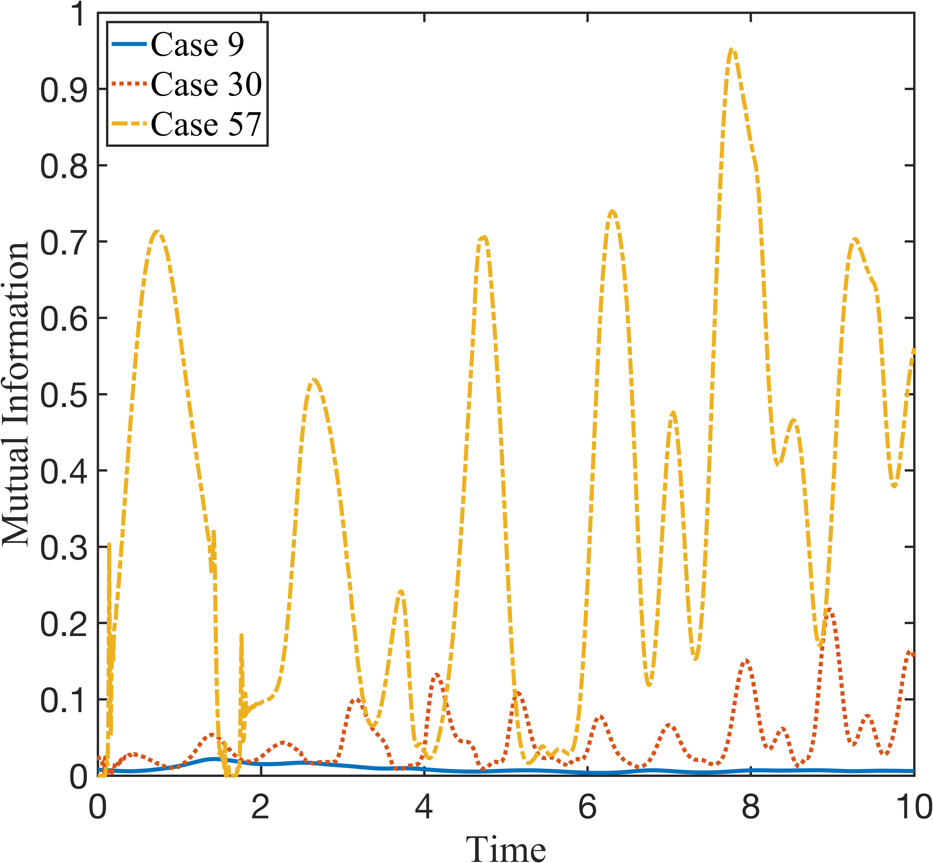
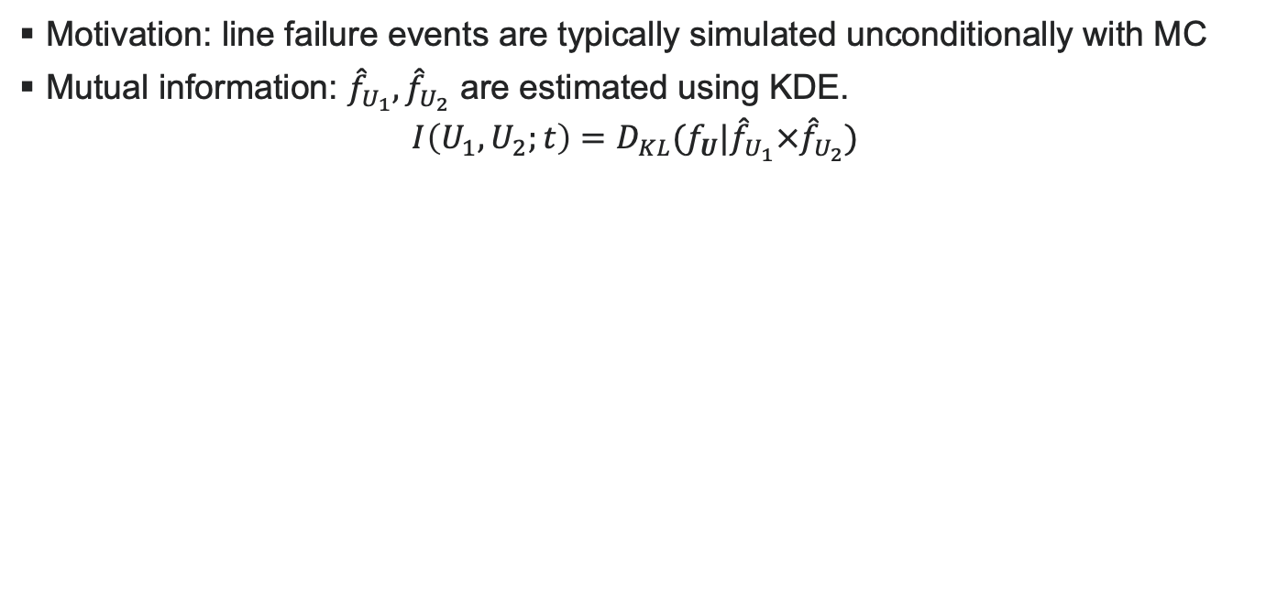
Measuring Information content
Motivation: line failure events are typically simulated unconditionally with MC
Mutual information: ${\hat{f}}_{U_{1}},{\hat{f}}_{U_{2}}$ are estimated using KDE.
$${I\left(U_{1},U_{2};t\right)=D}_{KL}(f_{U}|{\hat{f}}_{U_{1}}×{\hat{f}}_{U_{2}})$$

Slide 11
Thank you for listening! Questions?

